Slide 1


CNC Traning : shopbot
FabLab CEPT
Training session on cnc

Slide 2
Content
About shopbot PRS alpha
How to prepare your drawing file for shopbot cnc
Suitable materials
How to set cutting/engraving parameters
Starting the machine and its accessories
Setting up material and origin for cutting, focus point
Sending file to machine and start the cutting
Post cutting process
Safety measures

Slide 3
About cnc shopbot
The ShopBot PRS Alpha is a CNC machine that allows users to cut, drill, carve and machine
wood, plastic, aluminum and other materials along 3 axes, X, Y, & Z.

Slide 4
How to prepare your file for laser cutting
Usable formats .DXF
Compile all components in material size which you are going to bring here for cutting. And compile inside the reference box
Delete duplicate and overlapping objects
Join all the single objects and form a close boundary
Use layers/colors to differentiate different operation you want to do on machine
keep your drawing within 900*1200 mm

Slide 5
Few more points for design
Minimum distance between two line for full cutting is 1 mm for MDF and Paper, its 3 mm for acrylic
Minimum distance between two line for etching/marking/half cut is 0.3 mm
Layer colours should be other then Red and Black
Send design file for approval should be sent from same person who has booked the slot
For text etching, export it in line format (In Rhino explode text)

Slide 6
Suitable materials
Allowable materials:
Pine MDF (up to 7 mm thickness)
Plywood (up to 6 mm thickness)
Casted acrylics (up to 15 mm thickness)
Papers
Non plastic boards
Wood (for engraving)
Veneers
Prohibited materials:
Polystyrene, polypropylene, polycarbonate
Plastics containing chlorine and fluorine content based material
Any particle board other than Pine MDF
Rubber (All Forms)
Casting resins
Any kind of Metal

Slide 7
Possible operations
Cutting: for all materials
Folding: Papers and soft materials
Hatching/etching/marking: all materials
Note: Perform a test print from default test file provided on the desktop computer.

Slide 8
List of materials with cutting parameters
 | Material | Power | Speed (mm/sec)
1 | 3 mm pine MDF | 70 | 30
2 | 2.5 mm pine mdf | 65 | 30
3 | 1.5 mm pine mdf | 55 | 35
4 | 5 mm pine mdf | 75 | 17
5 | 3 mm acrylic | 68 | 30
6 | 2 mm acrylic | 65 | 40
7 | 5 mm acrylic | 75 | 12
8 | Card paper | 14-17 | 100
9 | Cartridge/jute paper | 12-15 | 100
10 | Jute or equivalent thick board (up to 1.2 mm) | 15-17 | 100

Slide 9
List of materials with Engraving/grooving parametersparameters
 | Material | Power | Speed (mm/sec)
1 | 3 mm pine MDF | 25 | 100
2 | 2.5 mm pine mdf | 20 | 100
3 | 1.5 mm pine mdf | 20 | 100
4 | 5 mm pine mdf | 35 | 95
5 | 3 mm acrylic | 20 | 80
6 | 2 mm acrylic | 15 | 95
7 | 5 mm acrylic | 30 | 95
8 | Card paper | 9-10 | 225
9 | Cartridge/jute paper | 9-10 | 300
10 | Jute or equivalent thick board (up to 1.2 mm) | 9-10 | 225

Slide 10
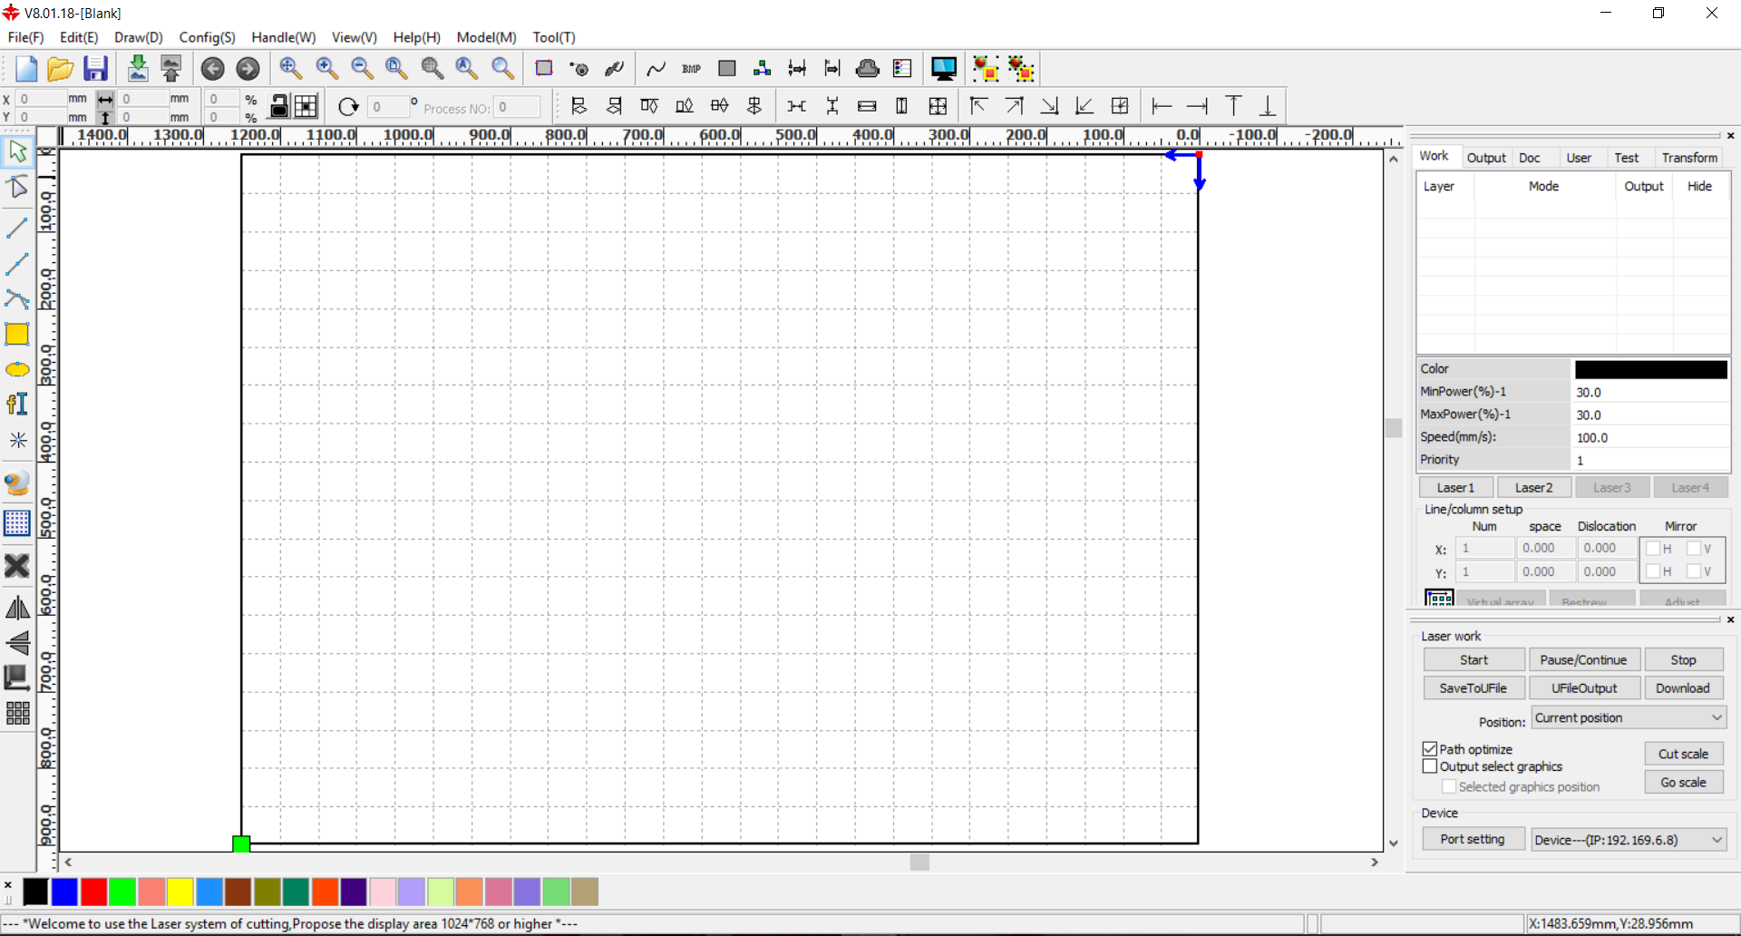
How to Set cutting/engraving parameters ?
Start software
RDworks

Slide 11
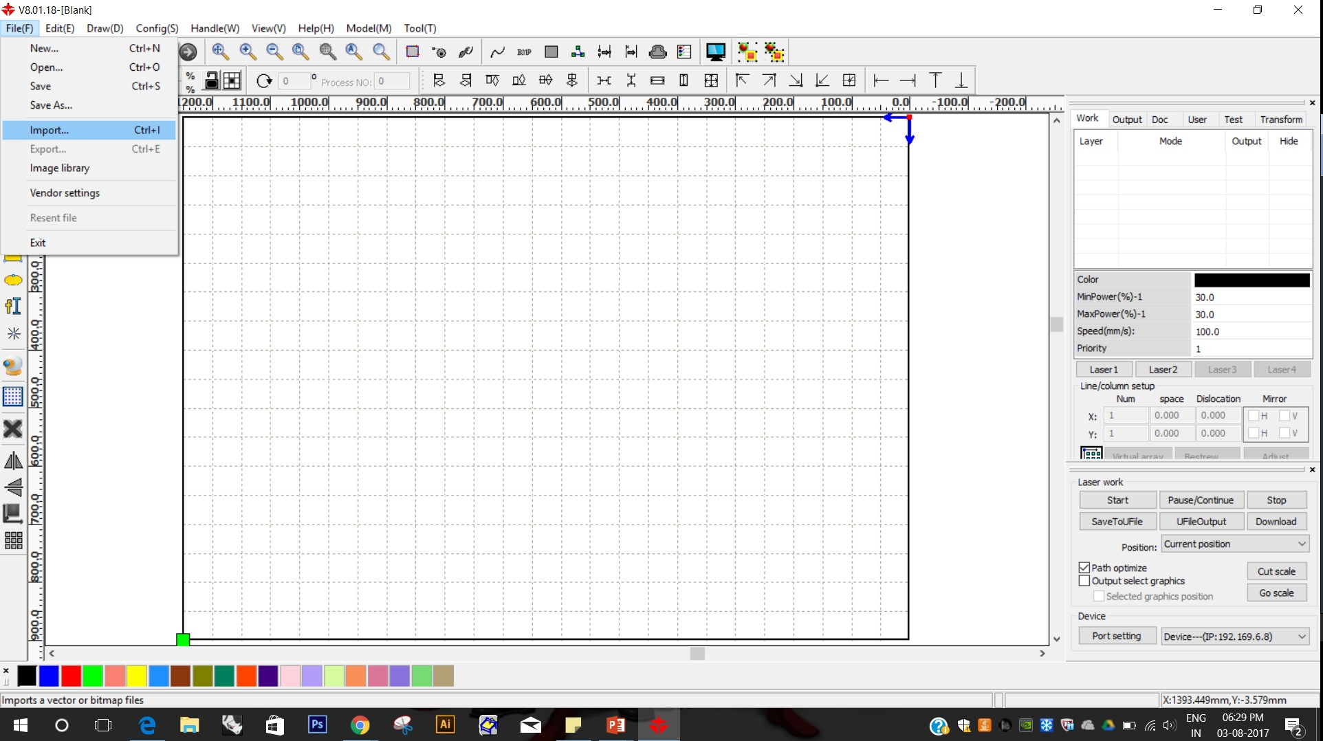
Import your .Dxf file

Slide 12
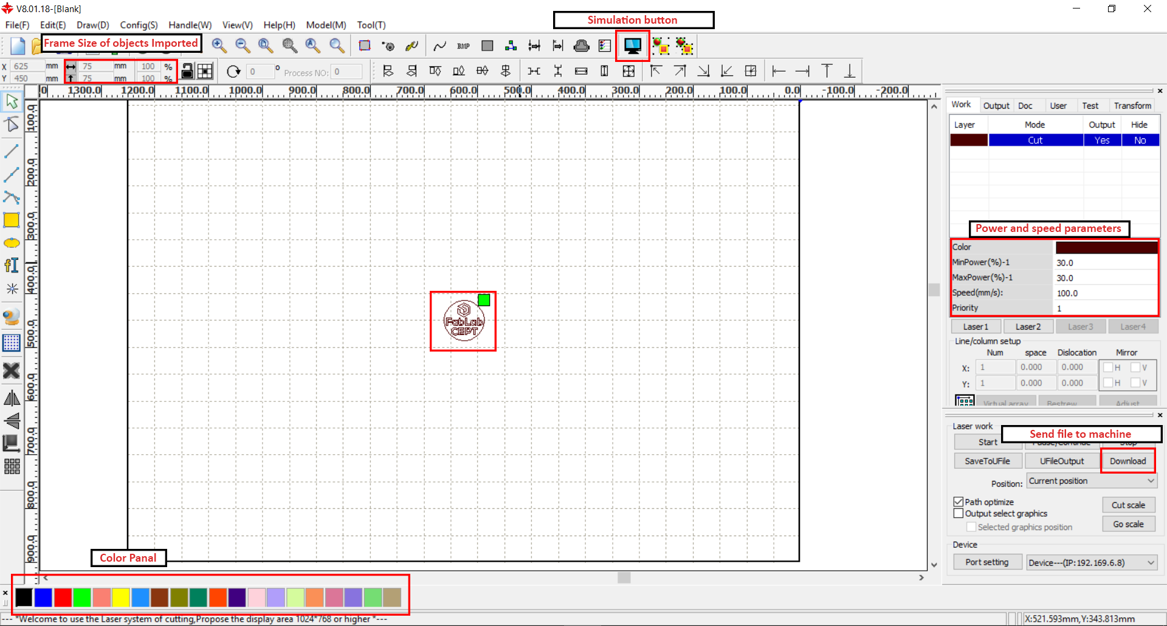
What you will find on screen ?

Slide 13
Set power and speed parameters from the penal shown in above photograph

Slide 14
After setting parameters check the simulation for correct flow of working

Slide 15
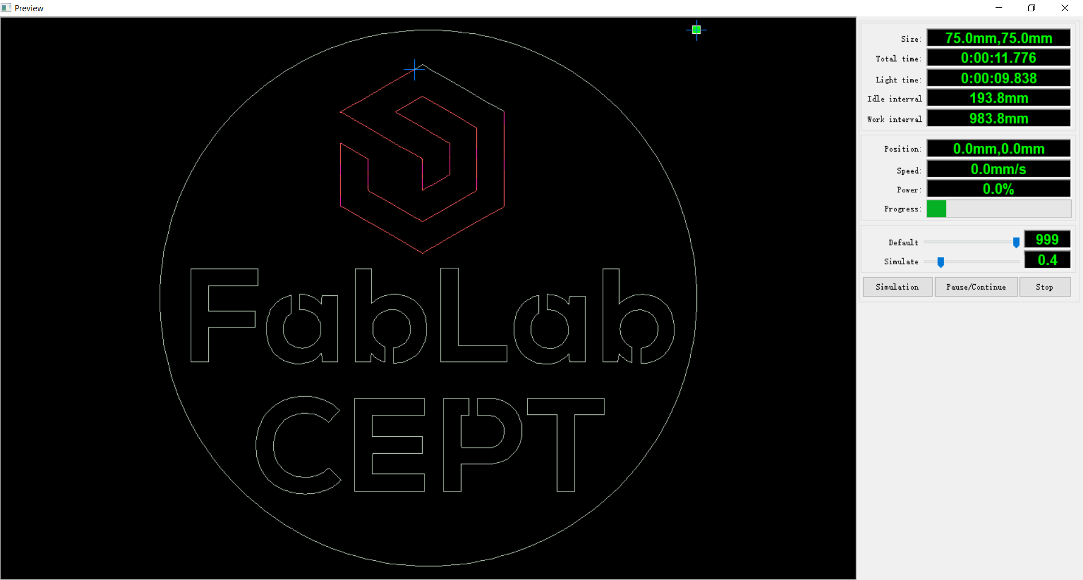
After setting parameters check the simulation for correct flow of working

Slide 16
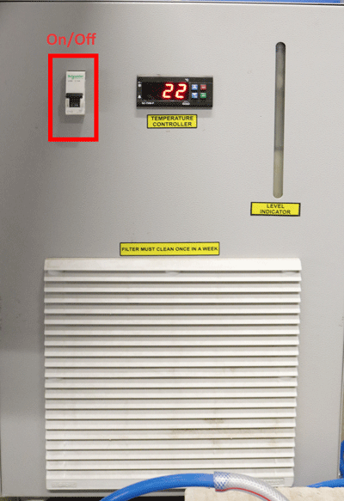
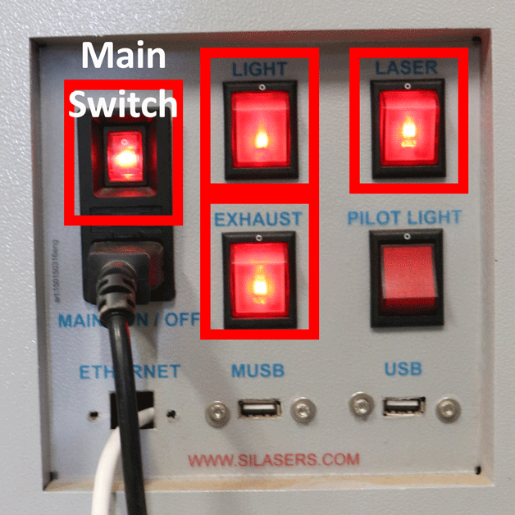
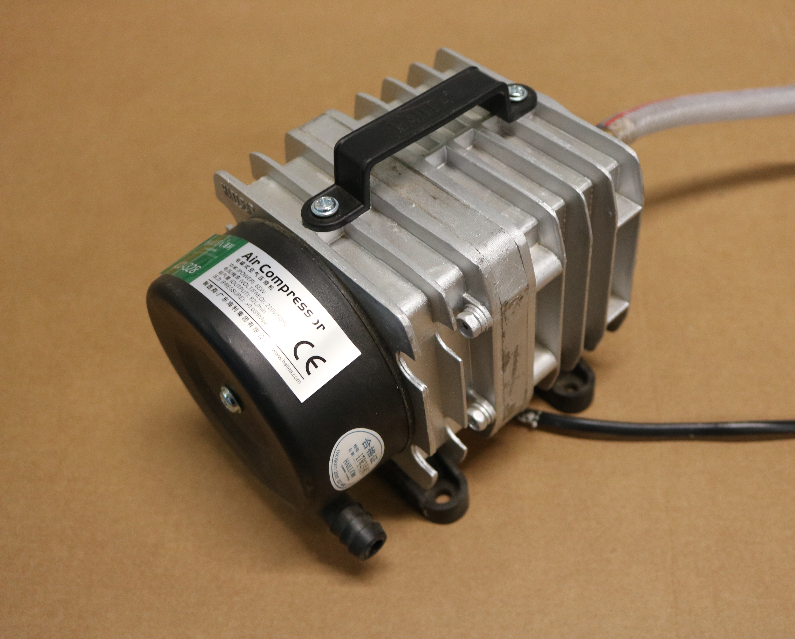
Start the machine, chiller, air pump
Turn on main switch, light, laser and exhaust.
Turn on air pump
Turn on chiller

Slide 17
Send file to machine using Download button

Slide 18
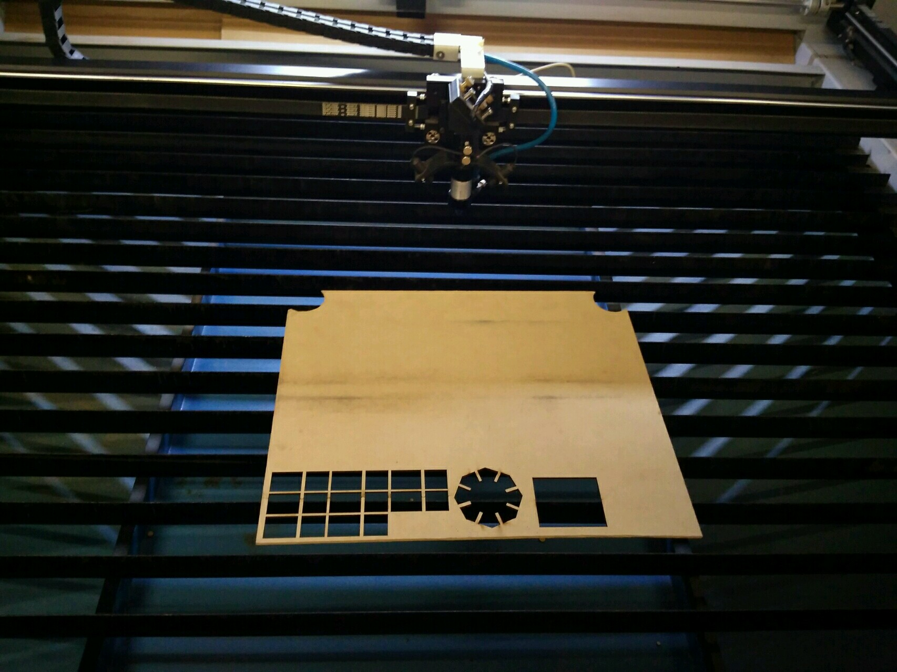
Keep the workpiece inside the machine
Note
Keep workpiece in such a way so that it will be parallel align to strips present there

Slide 19
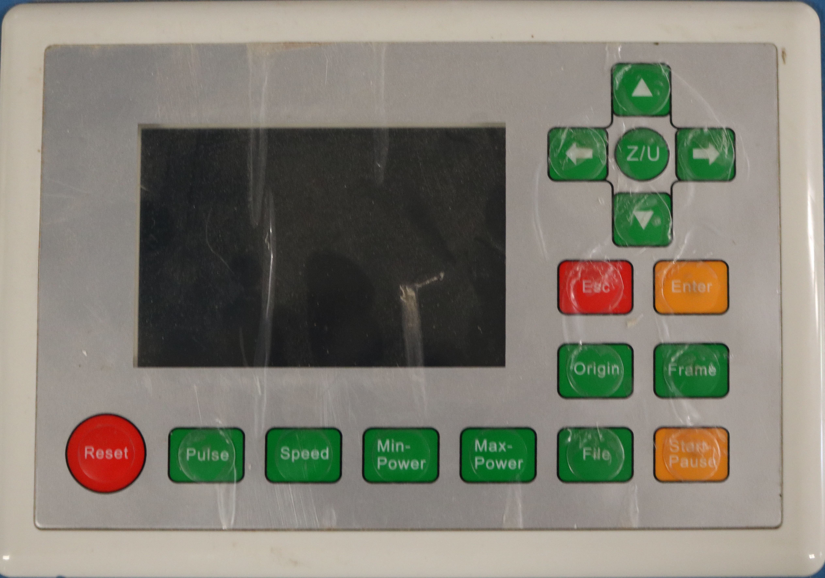
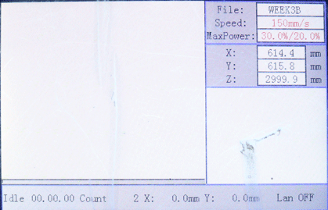
Come to Operate control panel
Above is the start screen which shows plain white area with no object.
Left is the control panel with buttons

Slide 20
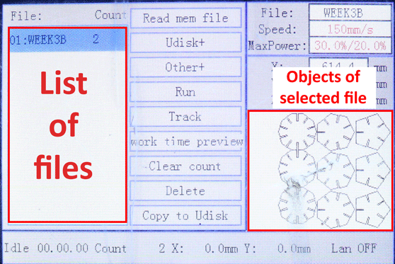
navigate your file and select it
Press file button which will show list of files in machine memory
You can also see objects of the selected file

Slide 21
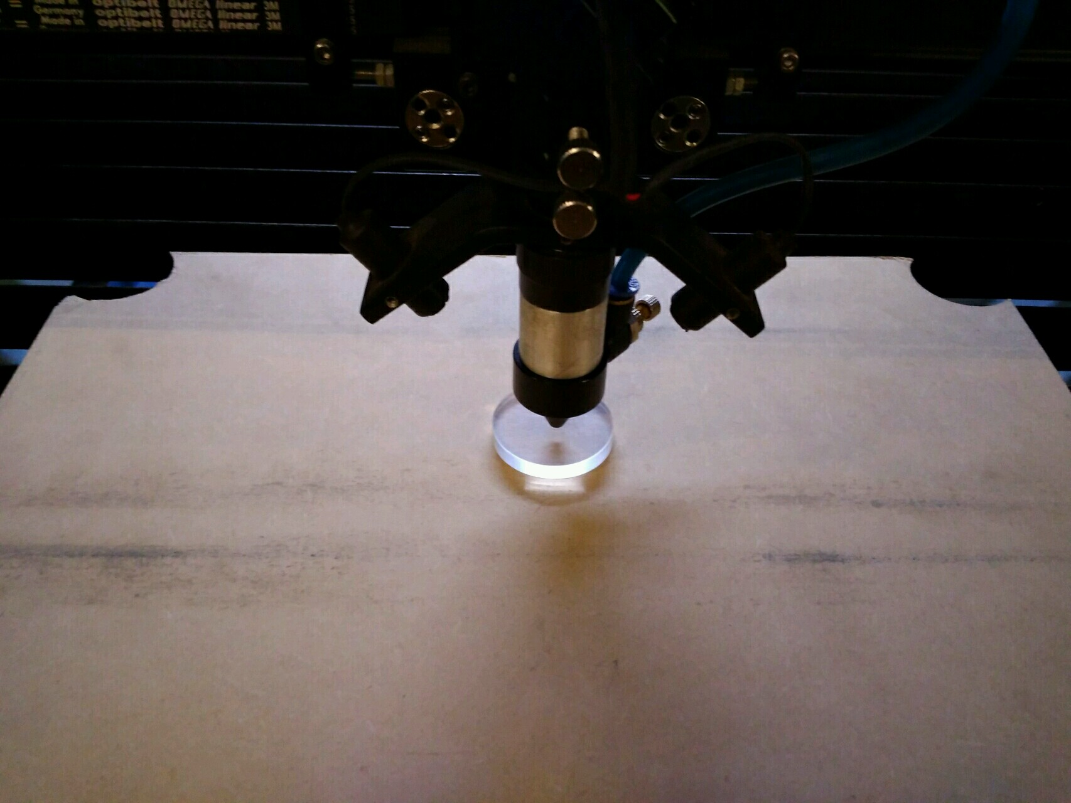
Focus the laser head using acrylic piece

Slide 22
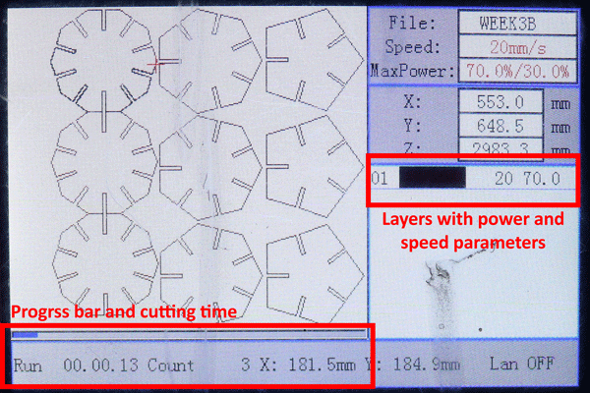
Check the size of file vs size of material
Once material size is set then you can start cutting by pressing start/pause button as shown
You can see progress bar, time of cutting and speed and power parameters of different layers while cutting

Slide 23
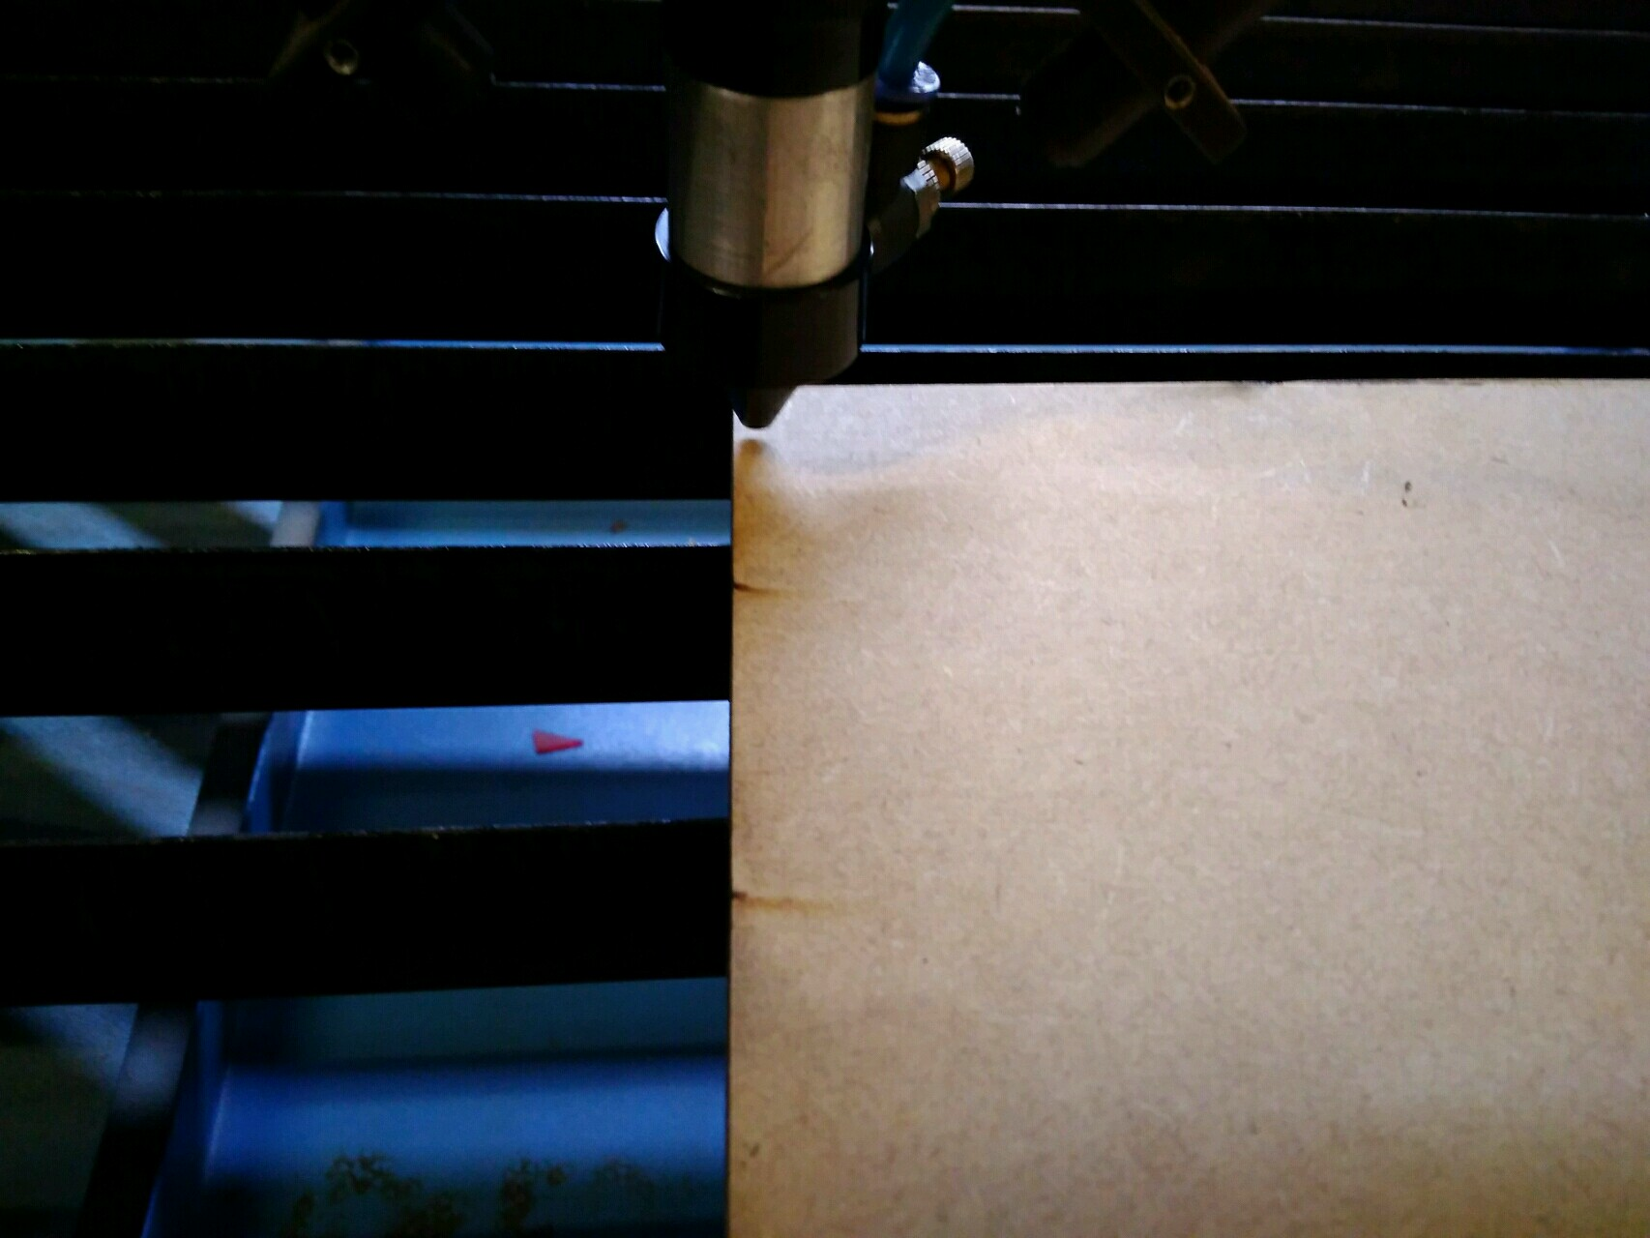
Set the corner of your sheet as origin
And Press frame
Note
On pressing frame laser head will move in boundary
of your design so you can check your so verify size of
File with size of board

Slide 24
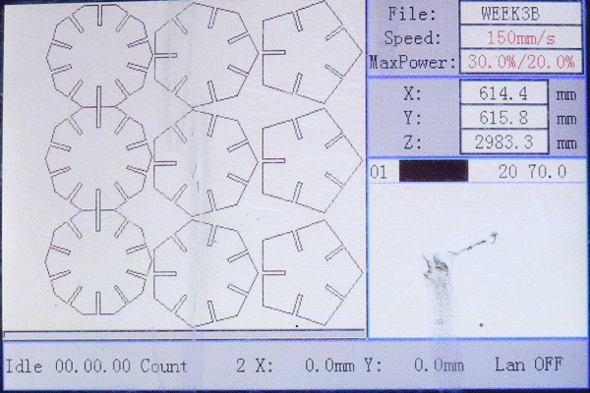
Check you material is in size of your file using Frame button
Press “Frame” button, which will mark cornering points of your file
Check your file, if frame is not as per the material

Slide 25
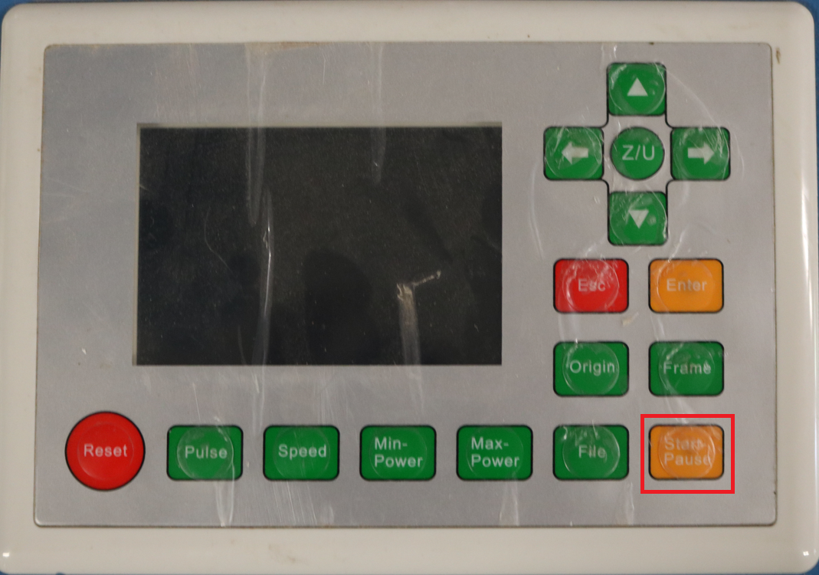
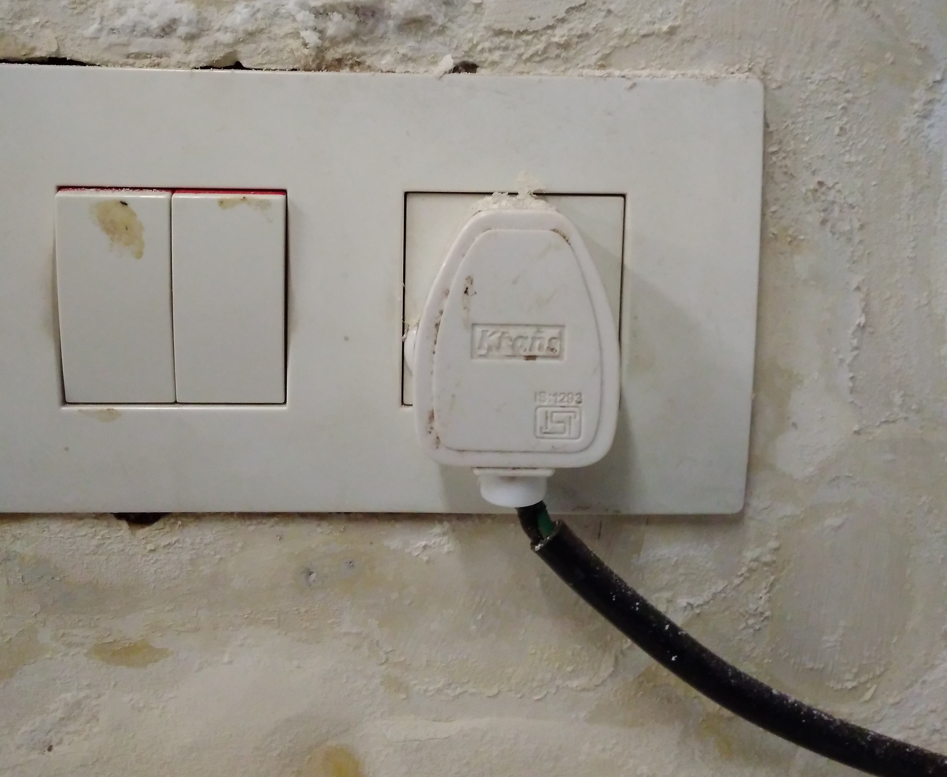
check exhaust switch on and
Press start button for giving cut
Machine switch
Switch on power socket
Press start button on machine

Slide 26
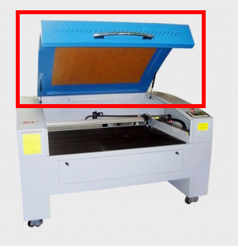
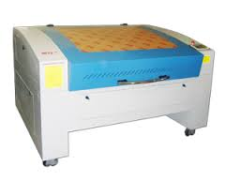
Close the hatch and Do not leave machine Unattended

Slide 27
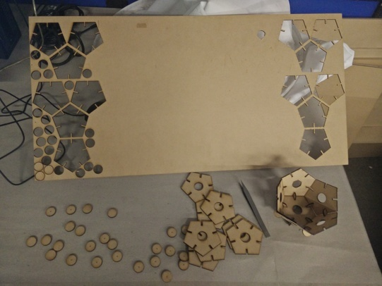
Post cutting process
Take out the cut parts and throw waste material for recycling/dustbins

Slide 28
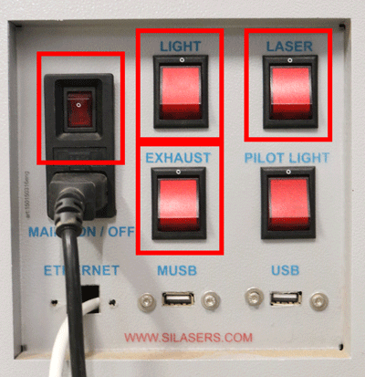
Post cutting process
Turn Off Light, Laser, exhaust and main switch
Step 1
Turn off Air pump
Air Pump
Step 2
Turn off Chiller
Step 3

Slide 29
Safety measures
You SHALL notify SpaceShop staff prior to running any job.
• You SHALL wear ear protection.
• You SHALL wear closed-toe shoes at all times.
• You SHALL wear eye protection when working with tools and processes
that involve chemicals, metal shards, wood chips or sawdust.
• You SHALL clean up your space after every job session, and leave 10-15
minutes for cleanup prior to shop closure.
• You SHALL secure badge and any loose items that might get caught in
moving machinery.
• You SHALL make small cuts at slow speed otherwise you will risk breaking
the cutting tool, and ruining your material.
• You SHALL hold the ShopBot Dongle(contains ESTOP,RESET, START
buttons) in your hand, during the entire operation of the ShopBot, for quick
access to the ESTOP in case of emergency.

Slide 30
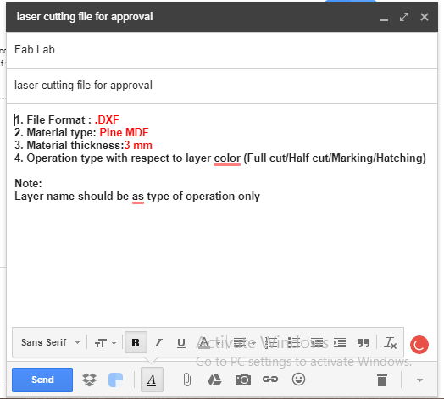
File approval format
1. File Format :
2. Material type:
3. Material thickness:
4. Operation type with respect to layer
colour (Full cut/Half cut/Marking/Hatching)
Note:
Layer name should be as type of operation only
Check all check points before sending file

Slide 32
Questions & answers
Let’s Start cutting…

